Slide 1
Healthcare Across Countries
A study by –
Mohini Agrawal
Sachin Balakrishnan
Pooja Dawada
Anshika Ahuja

Slide 2

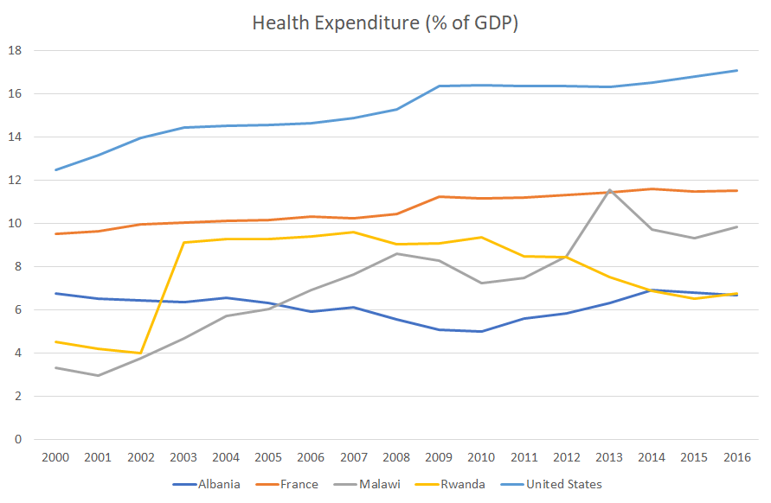


Overview
Project purpose
Healthcare expenditure polarities
How African, European and American systems differ
New Government was formed
A scandal in the finance department made all countries withdraw aid
What experts think
Vital links in the healthcare chain according to the experts
What people think
What people are talking about on Reddit / Quora / Wordpress
Notes:
Why these countries?
2003 - First multi-party parliamentary elections; President Kagame's Rwandan Patriotic Front wins absolute majority. (new government formed)
2013-Malawi finance
Why these countries - Rwanda-good public healthcare system in Africa(most appreciated)
Malwai-faces the largest number of concerns

Slide 3









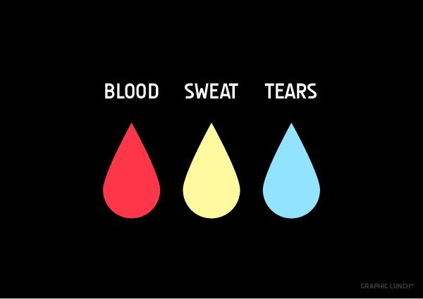
Data Extraction Sources
Expert Opinion | News Sites | Blogs | Discussions
Subscribers
330M
Subscribers
Subscribers
1 M
190M
+
Octoparse

Slide 4

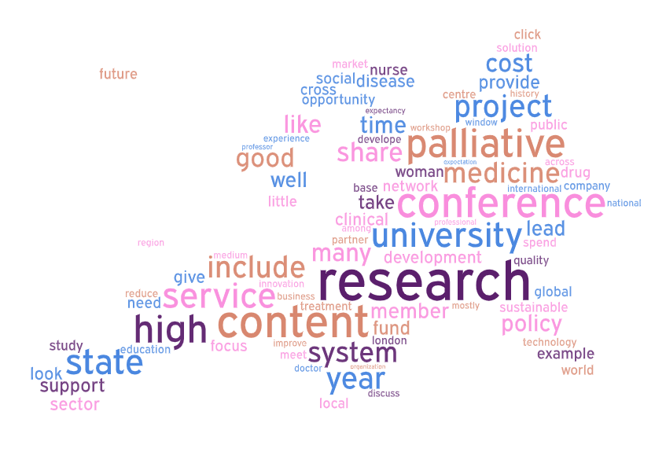
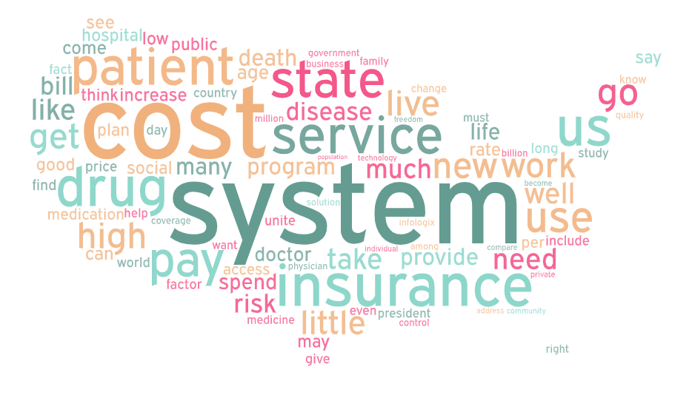
Topics that outshone

Slide 5
Topic Modeling
Tools - Scikit-learn and gensim.
Scit-kit gives more flexibility in terms of fine tuning the parameters.
Word pre-processing - Stopwords removal and lemmatization.
LDA modelling - hypertuned the parameters (number of topics, iterations etc) via sklearn Gridsearch.
Topic modelling was done on user opinions from three geographies with different healthcare standards - US, Europe and Africa.
Visualization was done with pyLDAvis library.
Notes:
Sci-Kit learn because it gives the flexibility of parameter tuning with Grid Search.

Slide 6


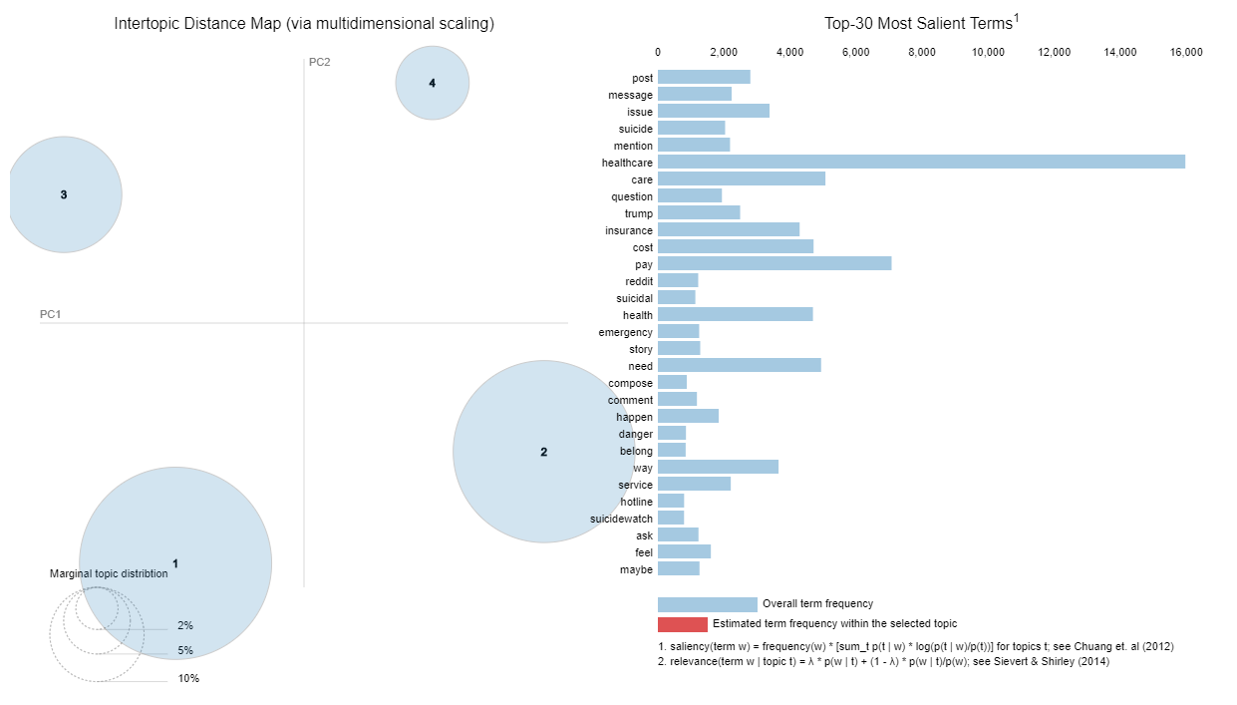


Themes on US
Government policies & candidates
Top discussions - Obamacare, Trump, Bernie Sanders. Users are comparing the current policies with past reforms.
Sentiment - Neutral
Information search
Top discussions - Suicide, Emergency, info, advice.
Sentiment - Neutral
Healthcare expense
Top discussions - Health Insurance, cost, income, affordability.
Sentiment - Negative
About current system
Top discussions - Change, Comparison, Capitalism, problems
Sentiment - Negative
Notes:
No surprise people are comparing the healthcare reforms from Obama’s time and Trump’s.
Negative Sentiments on healthcare and insurance expense.
Negative sentiments on current health system’s shortcomings and comparison.
Information Search - Suicide, emergency, advice seeking.

Slide 7
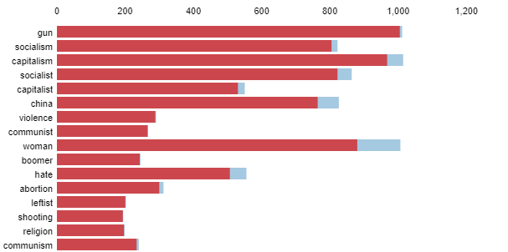
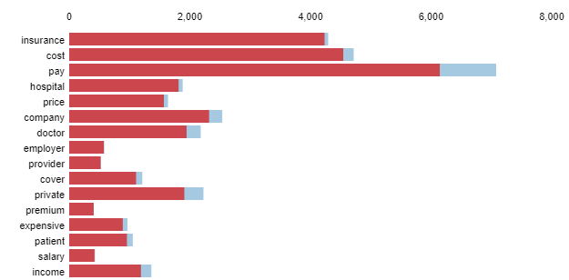
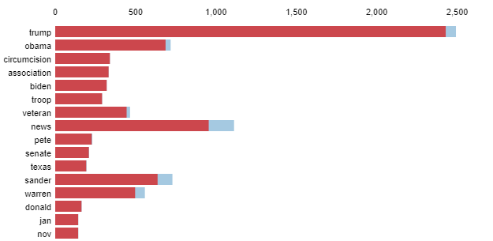
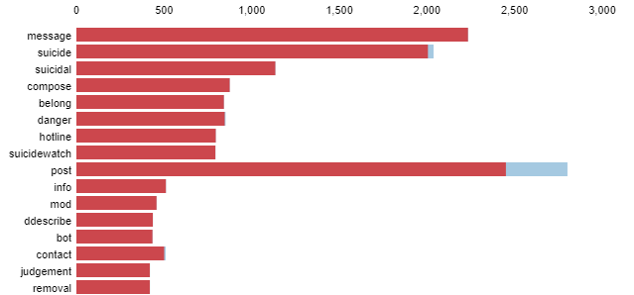
Topics - Healthcare discussions in US
Current system - Comparison, sentiment
Healthcare/Insurance expense
Government policies & candidates
Suicide, Emergency, Information
Notes:
Gun

Slide 8
Wait. What guns have to do with Healthcare?
US has the highest rate of gun homicides - 25 times higher than other developed nations.
Gunshot injuries pose a substantial financial impact to the US healthcare economy.
250,0000 patients were admitted for gunshot injuries from 2006 through 2014, which costed around $6 Billion in Healthcare.
The indirect costs of gun violence on the health care system can be hard to quantify.
Controlling gun violence could have a real positive impact on US healthcare system.
More revenue and resources can be made available for treating injuries of other types.
Notes:
It’s not just the expense, the time and effort spent in treating the gunshot injuries are also important factors.
More resources and revenue can be made available for treating injuries of other types.

Slide 9

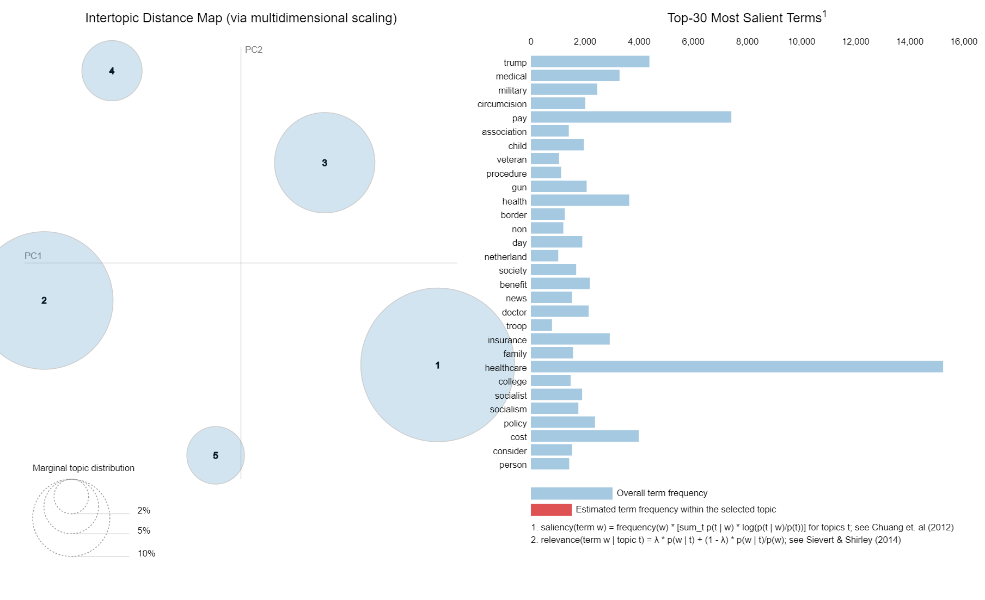

Themes on Europe
Quality/cost of Healthcare
Mixed opinions about the healthcare quality and cost across countries
Sentiment- Neutral
Surgeries and other care
Palliative other types of care
Government systems/reforms
Comparisons of past and present government systems across countries
Sentiment- Positive
Hate/Violence/Perils
Downsides of the systems and comparison to the US
Sentiment- Sad/negative
Notes:
General trend and topic remains the same as US.
People comparing Healthcare to other countries, discussions on cost.
One additional topic we could identify was the palliative care.
Palliative care is specialized medical care for people living with a serious illness. This type of care is focused on providing relief from the symptoms and stress of the illness. The goal is to improve quality of life for both the patient and the family.

Slide 10
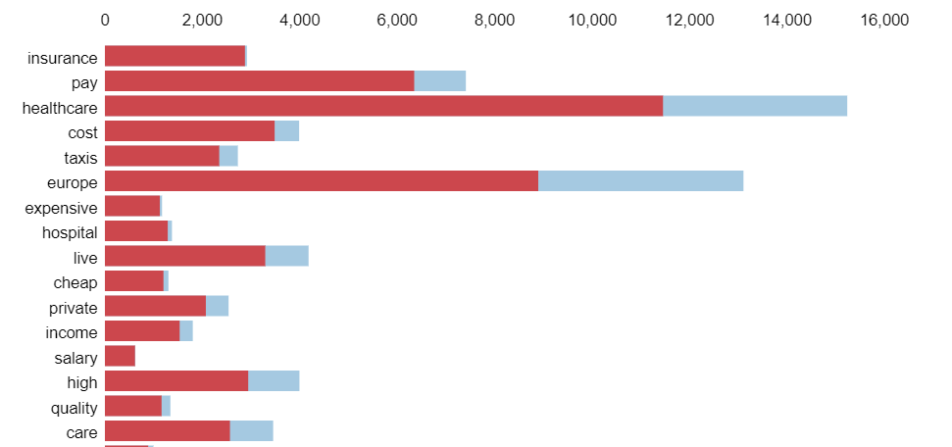
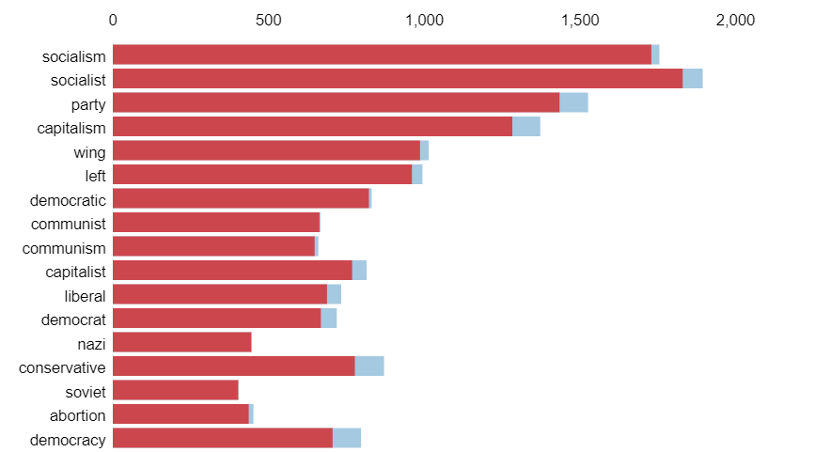
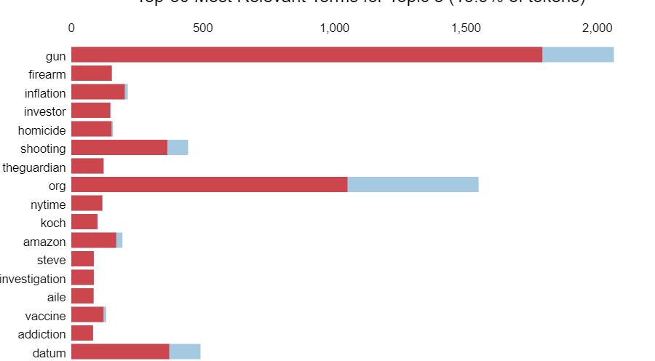
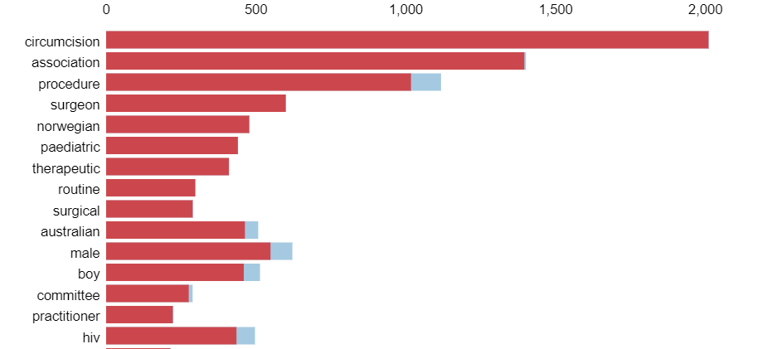
Themes on Europe
Quality/cost of Healthcare
Government systems/forms
Hate/Violence/Perils
Surgeries and other care
Notes:
keyword cheap appearing in the Cost/Quality topic.
Remember it was the keyword expensive that showed up in the US.

Slide 11


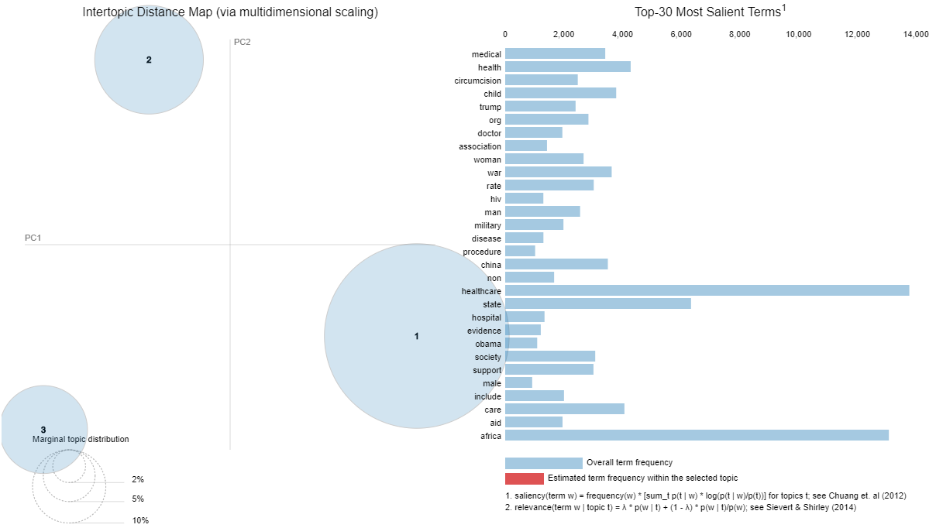

Themes on Africa
Hate towards Capitalism
Talk about poverty in the country and how capitalism in other countries affect them
Sentiment - Negative
Netherlands Surgeon Topic
Talk about the controversy around the Dutch surgeon in Africa who tried to raise awareness about effects of religious circumcision
Sentiment - Mixed
Politics in Healthcare
Comparing US presidential candidates, specifically at the time of last election, on how that election would affect them
Sentiment - Neutral
Notes:
Hate towards capitalism and how its affecting them
US politics and elections, how it will affect them. President Obama used to support the African healthcare system a lot, and it’s quite natural that people became sceptical when Trump came to power.
Interesting was a controversial topic - around a Dutch physician who tried to raise awareness about the effects of improperly conducted religious circumcision.

Slide 12
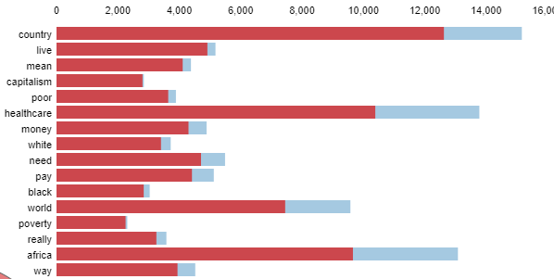
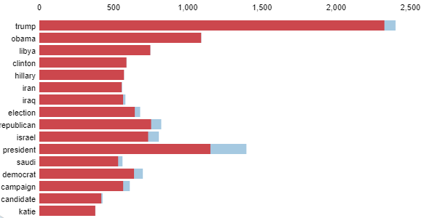
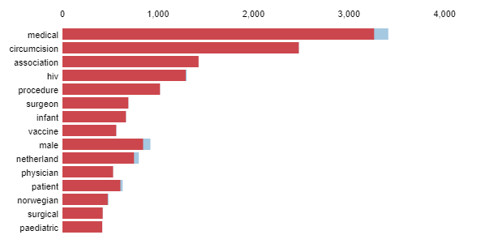
Themes on Africa
Hate towards Capitalism
Politics in Healthcare
Netherlands Surgeon topic

Slide 13

What experts say!
Medicare-for-all plan
A lot of people don’t have medical insurance coverage. Bernie Sander’s introduced a plan to transition to a single-payer health care system, which would mean that everyone will have health coverage and nobody would have to pay out of their pockets
Are suicide and death covered under insurance?
Under federal rules from the HIPAA, health plans can’t deny insurance because of a specific medical condition like depression. However, insurers sometimes refuse to cover injuries that are intentionally self-inflicted including suicide
How to improve the quality of healthcare facilities across regions
The healthcare systems across countries still face a significant number of challenges which need to be worked on. Experts are discussing and providing suggestions on how to improve the systems
Measure of price premium earned by healthcare providers
Heavy federal subsidies are designed to offset premium increases by insurers in the healthcare marketplace. That means there is more money being generated in that industry than ever before
Notes:
We performed topic modelling on blogs written by various experts. The main themes experts talk about are how the system can be improved in terms of better medicare for all, better quality of facilities as well as what all should be covered under insurance

Slide 14

Uninsured and Facing an Emergency? Know Your Rights!
As an uninsured individual, you have the right to adequate care at hospitals if your situation qualifies as an emergency
Do people trust the healthcare system?
The concept of trust in healthcare system is important because it involves a certain level or risk and uncertainty for the patient. Having high level of trust has benefits like perception of better care, greater acceptance to recommended treatment and adherence to treatment
How to improve quality of care in health facilities?
Improving patient care has become a priority for all health care providers with the overall objective of achieving a high degree of patient satisfaction. Health care systems in developing countries face an even greater challenge since quality and cost recovery must be balanced with equal opportunities in patient care
Government intervention in health care reforms
The success of any health ministry reforms depends on how progressively the government roles out the changes
Notes:
We also looked at news articles and the major themes being discussed are trust in the system, again how facilities can be improved and govt intervention

Slide 15

Unsupervised Extractive Summarization
Scrape data from Wordpress using Octoparse
Tokenize and vectorize each sentence (S)
Perform Cosine similarity (Top 10 sentences)
Blog 1
Blog 2
.
.
Blog n
S₁₁ | S₁₂| …….
S₂₁ | S₂₂| ….…
.
.
S_{n1} | S_{n2} | …….
S₁₁ ~ 60% of k₁
S₂₁ ~ 70% of k₂
.
.
S_{n1} ~ 10% of k₃
S₁₁
S₁₃
S₁₂
S₁₄
α
S₁₄
θ
θ
S₁₅
S₁₁
α
β
Notes:
performed unsupervised extractive summarization, most imp words and feelings
To better understand the the major themes we also performed summarization on wordpress blogs using cosine similarity

Slide 16
US blogs summarized
No less than 6 different statements were made by Mr Obama forcefully claiming in 2009 while addressing the American Medical Association:
“If you like your doctor, you will be able to keep your doctor, period, If you like your health care plan, you’ll be able to keep your health care plan, period.
At long last, after decades of false starts, we must make this our most urgent priority, giving every American health security — health care that can never be taken away, health care that is always there.
“I have always found a bit cruel the much-mouthed suggestion that patients should have ‘more skin in the game’ and ‘shop around for cost-effective health care’ in the health care market,” said Uwe E. Reinhardt, a health policy expert and professor at Princeton University, “when patients have so little information easily available on prices and quality to those things.”
President Obama’s Affordable Care Act, the health care overhaul law passed in 2010, tries to make some improvements (though the Supreme Court is expected to rule whether all or some of the law is constitutional this month).
While a European national health system seemed politically out of the question, pilot models in which employees of a Dallas school system were part of a collective payment system seemed to offer the best model to emulate more broadly in order to bring up hospital service demand as well as mitigate adverse selection of the sickest patients opting into insurance plans.
Another recent paper is a major new report from the National Bureau of Economic Research (NBER), which shows that when the poor have medical insurance, they not only find regular doctors and see them more frequently for preventive care, but also end up feeling healthier, less depressed and are better able to maintain financial stability.
Why getting sick in America is a really bad idea. May_30_Health_Care_Rally_NP (641) (Photo credit: seiuhealthcare775nw)
One element of living in the United States sickens me to my core — the persistent inequality of access to affordable quality health care, something citizens of virtually every other developed nation take for granted.
As the heated debate over health care continues, there has been plenty of talk about how the U.S. system stacks up to that of other countries, and how much American doctors earn compared with M.D.s in other parts of the world.
Expanding this program to include everyone regardless of their age would be necessary; signing up for Medicare at the same time one applies for a Social Security number (typically at a very young age) seems simple enough.
)How did we get to the point where the discussion on health care has come down to how much less coverage can be provided and how much tax relief can be granted to already rich people?

Slide 17
Europe blogs summarized
We hope the project will make a significant contribution to the history of health care provision by opening up local records in East-Central Europe for researchers and by placing hospital development in these countries in a Europe wide context.
Conference Dates: 13-14 September 2013 This conference seeks to bring together scholars working on topics related…02/08/2013In "history"The Value of Time and the Temporality of Value in Socialities of WasteDrawing from long-term ethnographic research on a 25-year-old medical aid program linking the U.S. and Madagascar, I use this brief essay to trace how Malagasy and American participants engender different orientations to time through their work with discards, as they transform both discards’ value and the social relations surrounding them.09/21/2015In "Economics/Economies"Conference on waste and pollution in healthcare. Healthcare Without Harm is an NGO dedicated to promoting environmental justice.
Today, the best tool we have for attempting any large scale changes in the way we view and talk about mental health is education.
I am certain that this latest edition of the Directory will be used by many actors in health and will provide useful guidance and open access to patient groups in the European Union and beyond. We should be cautious that even within Europe, systems like Germany that have some degree of private insurance are quite different from systems like the U.K. where the National Health Service was once quite universally dominant and is now under flux with calls for reform (despite evidence that it works much better than the post-reform version would) from the new conservative government.
Over 30000 registered doctors in the UK gained their primary medical qualification in another European Economic Area state and over 150000 EU citizens work in the UK’s health and social care sphere – with free movement playing a crucial role in both professional development and in meeting varying health and social care, including medical, workforce requirements across Europe.
During the next network event, a study visit to Centralsjukhuset Kristianstad on September 27th, we will be able to look at some of the hospital’s energy efficient solutions, gain an unique insight to investments in sustainable healthcare, meet key persons in the process as well as have a closer look on real-life sustainability projects in a hospital environment.
The aim of this event was to show how innovation influences the medical and healthcare sector and how, ultimately, the improvements obtained have positive repercussions on patients’ lives. Over breakfast, Ms Denjoy began her presentation by giving a picture of the role COCIR plays and by underlining the main sectors of its influence.
In order to do that, we will be bringing on stage those who are shaking things:
Empowered physicians and nurses who are using digital tools in their daily routine
Investors who have been investing in digital health projects this past year
Successful entrepreneurs whose solution is improving efficiency, reducing costs and proved to be a positive return on investment.
The discussion among participants showed that this vision is already reality for many and that the right tools and strategies to manage a digital work environment will become even more relevant in the future.

Slide 18
African blogs summarized
From my very limited understanding I think one of the goals would be to help medical students and medical practitioners act in more â€“ in less mechanical ways, more humane ways.
It has held six successful elections since the 1992 end of military rule. Its economy has also been strong in recent years, with 14% growth in 2011 and some eight percent in 2012.But Gates and others point out that one of the real secrets of its success has been the way its health service is organised, to ensure as many babies are vaccinated as possible.
As a participant you will have the opportunity to learn how to use the limited resources at your disposal to deliver health care at all times. One of the questions asked most by participants who want to take part in our programs is of how a typical day with Elective Africa healthcare internships There is a long history particularly in this country, of the use of theatre in that way, in medical education; but I suppose the issue is that it’s not mainstreamed; it comes down to the initiative of a particular clinic, doctor’s targeted niches, or targeted schools, because not all schools have the privilege of having people coming to perform.
Over the next several days, thousands of Rotarians and partners rolled up their sleeves to work together
Minister of Health Atupele Muluzi has said Malawi and many of the 18 ARIPO member states have made great strides in improving public health and by consequence, human development outcomes in recent years. He said that despite significant progress, the burden of infectious diseases, particularly HIV, malaria and Tuberculosis pose a threat to public health.
The meeting aims at providing a forum for ARIPO countries to exchange views and to share experiences on best practices that promote availability and access to affordable health coverage, Tembenu added.The high-level meeting has been jointly organised by the Malawi government and the United Nations Development Programme (UNDP).
More than 90% of Rwandans are now covered under the community-based health insurance scheme known as Mutuelle de SantÃ
Following problems in recent years with low real uptake numbers and poor service delivery, the government transferred management of the scheme to the Rwanda Social Security Board
According to the Ministry of Health, management of the scheme has improved since it was moved to RSSB in 2015, but some citizens say the quality of services is still wanting.
The scheme has been touted as one of the most successful on the continent and is credited for the country’s lower maternal and infant mortality rates of 77% and 70%, respectively, since 2000
Some of the main challenges are non-communicable diseases (NCDs) such as cancer, diabetes and kidney disease, which are costly to treat.
Maternal and child health are the main areas to be covered in Kenya’s new pilot programme. Yeah, but also more generally the greater emphasis on primary healthcare â€¦ in informal settlements around Khayelitsha in Cape Town, the clinic structure has improved
Notes:
Highlights resonate with what we found in topic modelling

Slide 19

Highlights
Despite US spending the most in healthcare industry, people’s sentiments are mostly negative
The Dutch surgeon topic was so controversial and highly visible that we came across it in both Africa and Europe forums
Palliative care:
Europe - people talk in context of mental health
Africa - people talk about it in association with cancer
Controlling gun violence can have a significant positive impact on the healthcare industry in developed countries
Blogs about African healthcare talk about missing empathy among the healthcare providers, limited resources and the deficit in effective vaccination programs
Theatre plays a prominent role in spreading healthcare related awareness in Africa

Slide 20
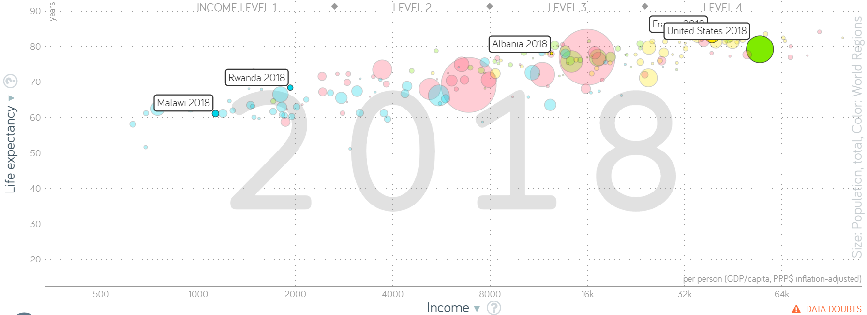
Life Expectancy is shown as a proxy for healthcare

Slide 21
Questions?

